Slide 1

Web Development 1
© Hugh McCabe & Matt Smith 2008-2014
Lecture 2a -
HTML block-level elements, and comments
<p>, <h1..6>, <hr>, <ul>, <ol>, <li>, <!-- bla bla -->

Slide 2
Introduction
This week we are going to look at how to use HTML to correctly mark up text.
We will look at various elements available
Remember: will be using these elements to attach meaning to the document, not to control presentation.

Slide 3
Block Level Elements
Here are the block level elements you need to know:
Type | Element(s)
Paragraphs | p
Headings | h1, h2, h3, … h6
Horizontal rules (lines) | hr
List elements | ol, ul, li
Here are some less used ones …
Block (long) quotes | blockquote
Preformatted text | pre
List elements | dl, dt, dd

Slide 4
Paragraphs
<p>
</p>

Slide 5
Paragraphs the most rudimentary element of a text document
To define a paragraph insert an opening <p> tag at the start and a closing </p> at the end.
<p>
This is an example of a paragraph. Usually a paragraph is a group of sentences that relate to each other thematically
</p>
<p>
Here is a second paragraph. I really should think of something different to write about for the second one but I’m not feeling very inspired this morning.
</p>

Slide 6
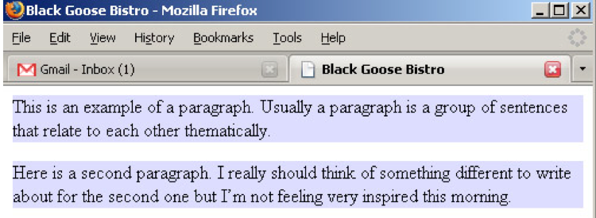
Block Level Elements
Remember that a block level elements means that the browser surrounds the content with an imaginary box.
I’ve put in a style below to turn the background of the block blue to make this obvious

Slide 7
Paragraphs
Paragraphs may contain text, images and other inline elements.
They may not contain other block level elements.
So for example, you can’t have another paragraph inside a paragraph.
So none of the elements appearing in the table on slide 4 can go inside a paragraph.

Slide 8
Headings
<h1> text/image goes here </h1>
<h2> text/image goes here </h2>
Etc.
<h6> ….. </h6>

Slide 9
Headings
Headings
We have already used the h1 and h2 elements.
There are actually six levels of headings, h1 to h6.
Headings provide a logical hierarchy to a document and hence it is correct to start with a h1 heading and work down numerically.
This improves accessibility and helps search engines.
The example on the next slide shows some mark-up for four heading levels.
The slide after that shows the default rendering in a browser. This can be changed using a style sheet.

Slide 10
Block Level Elements
h1
<h1>IT Blanchardstown</h1>
<h2>Departments</h2>
<p>There are a number of academic departments at IT Blanchardstown, each specialising in specific subject areas.</p>
<h3>Informatics</h3>
<h4>Description</h4>
<p>The Department of Informatics delivers courses in Computing and related subjects.</p>
<h4>Personnel</h4>
<p>The Department has 20 full time staff.</p>
<h3>Engineering</h3>
<h4>Description</h4>
<p>The Department of Engineering delivers courses in Electronic engineering and Computer Engineering</p>
h2
h3
h4
h4
h3
h4

Slide 11
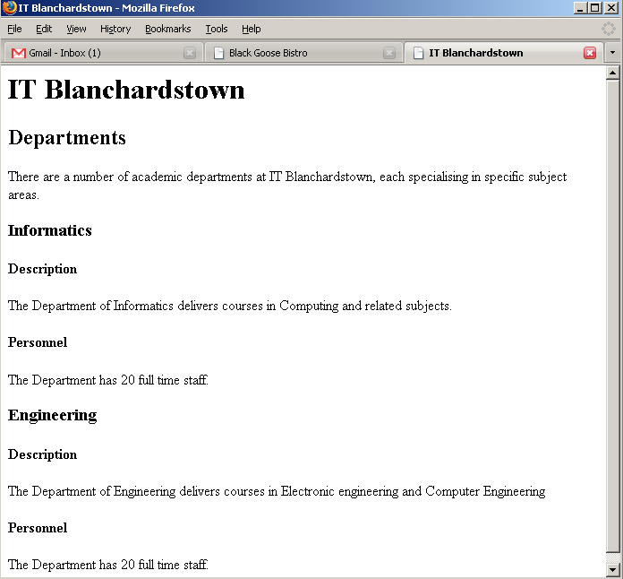
Block Level Elements
<h1>
<h2>
<h3>
<h4>
<h4>
<h3>
<h4>

Slide 12
Please note – heading numbers are importance (not the sequence on the page)
<h1> means MOST important heading level
NOT the first heading
<h2> means a sub-heading (second level heading)
NOT the second heading
<h3> means a sub-sub-heading (third level)
NOT the third heading
Do not write:
<h1>
<h2>
<h3>
<h4> just because the numbers go up sequentially !
Most documents: h1 h2 p h2 p h2 p etc.

Slide 13
Horizontal rules
<hr>

Slide 14
Horizontal Rules – (insert line here …)
used to add dividers between sections of the document “a shift in themes”
They are designated by a hr element.
An empty element so to conform to the HTML rules it should be written as <hr>
So for example:
<h3>Example of the use of a horizontal rule</h3>
<p>Horizontal rules are used to divide sections
</p>
<hr>
<p>Not much to it really, is there?
</p>

Slide 15
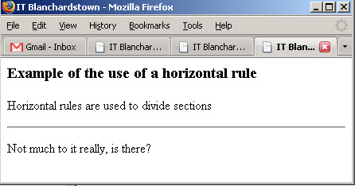
Block Level Elements
As with any other element, we can use style sheets to control how the horizontal rule is displayed.

Slide 16
LISTS

Slide 17
Lists
List elements
used when we want to itemise information, rather than break it up into paragraphs.
3 main types:
UL: Unordered lists: items that appear in no particular order
Default to bullet points (like this slide!)
OL: Ordered lists: lists of items in which the sequence is important
Default to numbered lists (1,2,3…)
DL: Definition lists: lists that consist of terms and definitions
(to keep things simple, we’ll not look at these until next semester)

Slide 18
UNORDERED LISTS
<ul>
<li></li>
</ul>
ORDERED LISTS
<ol>
<li></li>
</ol>

Slide 19
Unordered lists
Unordered lists
We identify these using a ul element.
The opening <ul> tag goes before the first list item and the closing </ul> tag goes after the last one.
Each list item get’s marked up using a li element.
This is done by enclosing it in opening (<li>) and closing (</li>) tags.
The following slide shows an example.
The slide after that shows how this would be rendered in a browser.

Slide 20
Block Level Elements
<!DOCTYPE html>
<html>
<head>
<meta charset="utf-8">
<title>IT Blanchardstown</title>
</head>
<body>
<ul>
<li>Hugh McCabe</li>
<li>Anthony Keane</li>
<li>Arnold Hensmann</li>
<li>Ronan Mullen</li>
<li>Kevin Farrell</li>
</ul>
</body>
</html>

Slide 21
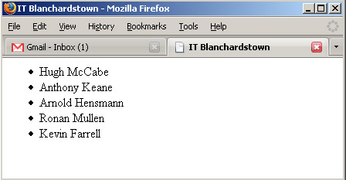
Block Level Elements
Bullets added automatically by browser
Again, display can be controlled by style sheets

Slide 22
Ordered lists
Ordered lists
Exactly the same as unordered lists except use the ol element instead of the ul element.
Instead of bullets, the browser will insert numbers.
For example:
<ol>
<li>Hugh McCabe</li>
<li>Anthony Keane</li>
<li>Kevin Farrell</li>
</ol>

Slide 23
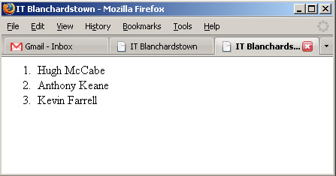
Block Level Elements
If you want numbers to start at something other than “1” use the start attribute e.g.
<ol start=“3”>

Slide 24
NESTED LISTS
<li>
(another list in here!)
</li>
Hint – great for site maps

Slide 25
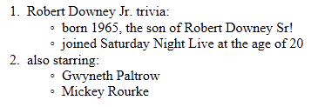
Nested lists
Nested lists
You can “nest” lists, so a list item can contain a complete list,
for example: here we see each ordered list element also contains its own complete unordered list:

Slide 26
Nested lists
<ol>
<li>
Robert Downey Jr. trivia:
<ul>
<li>
born 1965,
the son of Robert Downey Sr!
</li>
<li>
joined Saturday Night Live
at the age of 20
</li>
</ul>
</li>
etc.
nested list
Note, nested list fully inside the list item

Slide 27
HTML comments

Slide 28
HMTL COMMENTS
You can add ‘comments’ in your HTML code
They are IGNORED by browser
Useful for:
Making HTML text more human friendly to read
Temporarily removing convent from the document
NOTE the 2 minus-signs, and no forward slash closing tag …
<!--
I am an HTML comment and will be ignored
-->

Slide 29
HMTL COMMENTS – for humans
<!DOCTYPE html>
<html lang="en">
<head>
<meta charset="utf-8">
<title> comment for human example </title>
</head>
<body>
<!-- get new catch phrase – this one is too ‘Frasier’ -->
<h1>Matt’s blog “I’m writing”</h1>
<h2>Difference between dogs and cats</h2>
<p><strong>Dog</strong>dogfood for breakfast – my favourite. Left over sausage and chips – my favourite. Playing fetch – my favourite.</p>
<p><strong>Cat</strong>Day 4320 of my incarceration. This morning I scratched one and began a hunger strike turning my nose up at the warm milk and smoked salmon, but to no avail. My captors made an alternative meal of pouches and dry mix!</p>
</body></html>

Slide 30
HMTL COMMENTS – comment-out code
<!DOCTYPE html>
<html lang="en">
<head>
<meta charset="utf-8">
<title> comment for human example </title></head>
<body>
<!-- get new catch phrase – this one is too ‘Frasier’ -->
<h1>Matt’s blog “I’m writing”</h1>
<h2>Difference between dogs and cats</h2>
<p><strong>Dog</strong>dogfood for breakfast – my favourite. Left over sausage and chips – my favourite. Playing fetch – my favourite.</p>
<!--
<p><strong>Cat</strong>Day 4320 of my incarceration. This morning I scratched one and began a hunger strike turning my nose up at the warm milk and smoked salmon, but to no avail. My captors made an alternative meal of pouches and dry mix!</p>
-->
</body></html>
this cat HTML paragraph will NOT be seen in browser...

Slide 31
Summary and Conclusions

Slide 32
Summary and Conclusions
Basic BLOCK-LEVEL elements for mark-up
<p> paragraphs
<h1> … <h6> headings
<hr> horizontal rule
Lists
UL – unordered (bulleted)
OL – ordered (1,2,3…)
Both kinds of list contain <LI> list items
And NESTED LISTS (put a whole list inside a list item)
Comments (ignored by browse)
<!-- write your comment here -->

